Slide 1
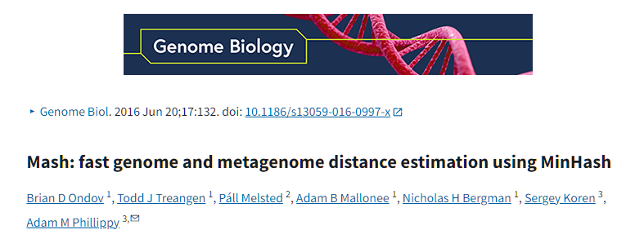
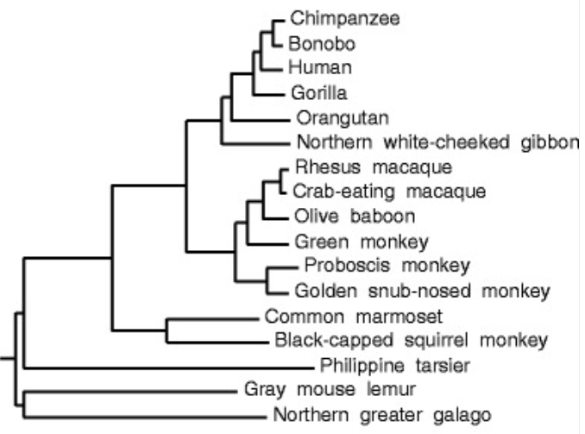
Similarity of genomes
There are many assembled genomes available
Can we figure out how similar two genomes are?
Can use alignment, but what if we have 1000’s of genomes?
Can use Jaccard similarity index!

Slide 2
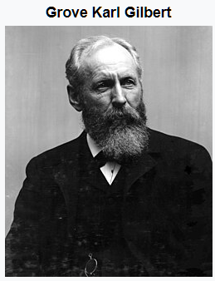

Jaccard similarity index
The Jaccard index is a statistic used for gauging the similarity and diversity of sample sets. It is defined in general taking the ratio of two sizes (areas or volumes), the intersection size divided by the union size, also called intersection over union (IoU).
It was developed by Grove Karl Gilbert in 1884 as his ratio of verification and now is often called the critical success index in meteorology.
It was later developed independently by Paul Jaccard, originally giving the French name coefficient de communauté (coefficient of community)
Images credit: wikipedia

Slide 3
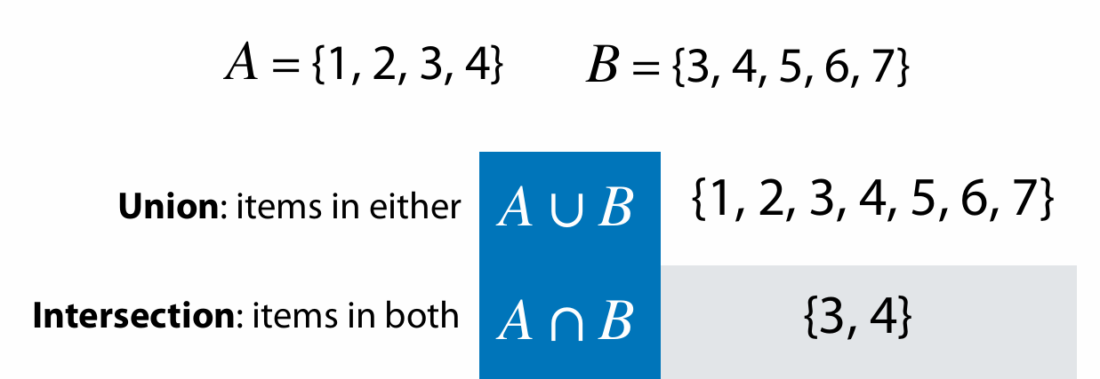
Sets
Adapted from Ben Langmead https://www.cs.jhu.edu/~langmea/resources/lecture_notes/140_similarity_pub.pdf

Slide 4
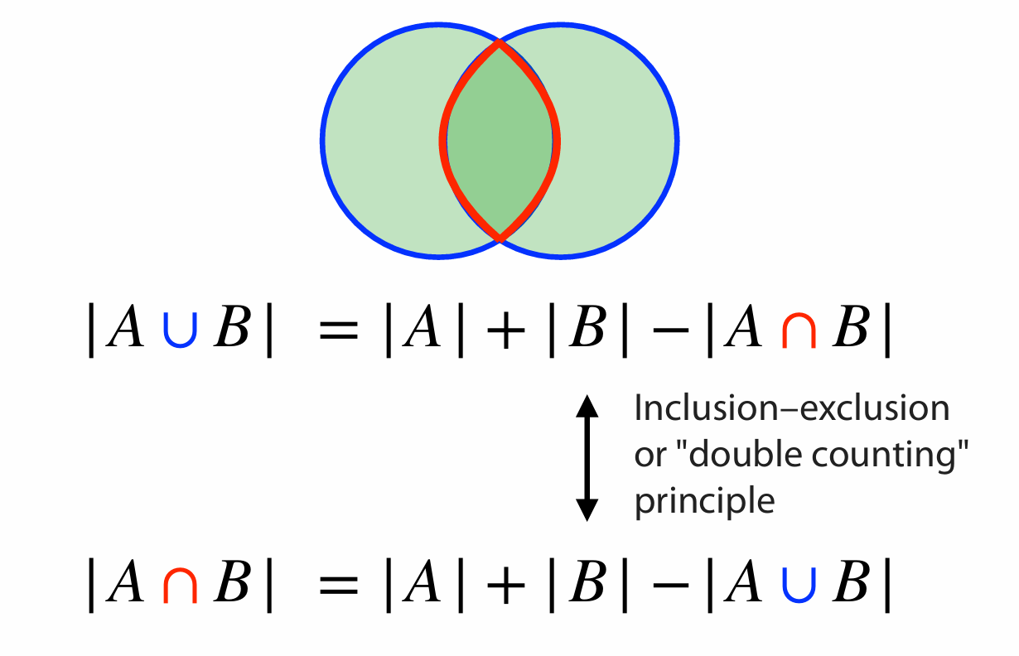
Sets
Adapted from Ben Langmead https://www.cs.jhu.edu/~langmea/resources/lecture_notes/140_similarity_pub.pdf

Slide 5
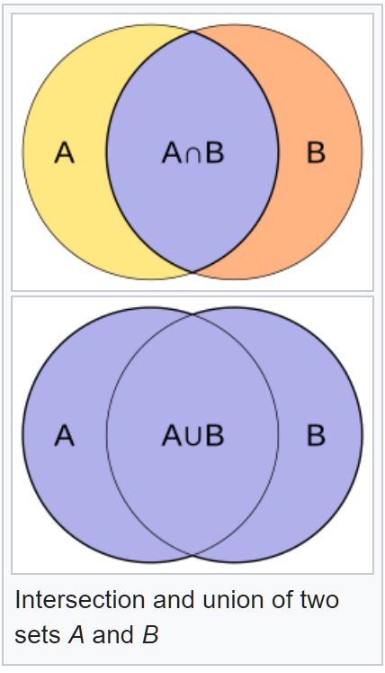


Jaccard index (or coefficient)
The Jaccard index is a statistic used for gauging the similarity and diversity of sample sets. It is defined as the intersection size divided by the union size, also called intersection over union (IoU):
$$J\left(A,B\right)=\frac{\left|A\bigcap{B} \right|}{\left|A\bigcup{B} \right|}$$

Slide 6
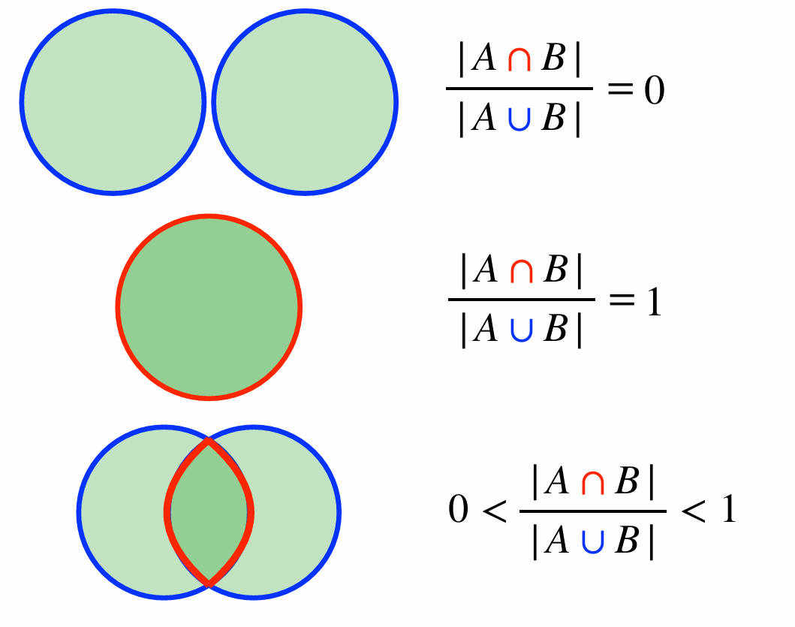
Jaccard coefficient
Adapted from Ben Langmead https://www.cs.jhu.edu/~langmea/resources/lecture_notes/140_similarity_pub.pdf

Slide 7
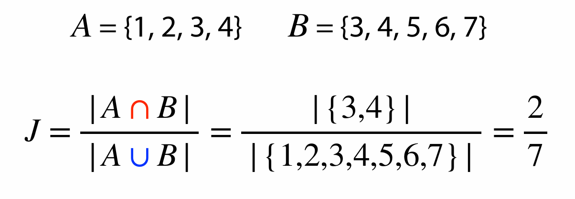
Jaccard coefficient
Adapted from Ben Langmead https://www.cs.jhu.edu/~langmea/resources/lecture_notes/140_similarity_pub.pdf

Slide 8

Jaccard index for genome similarity/alignment
Have genomes A and B
Get all canonical K-mers from A and B
Jaccard similarity can be computed from distinct K-mer sets in A and B
Hash each K-mer to an integer h(k)
K-mer sets could be large
Can use sets of distinct minimizers M(A) and M(B):
$$J(A,B)=\frac{\left|M(A)\bigcap{M(B)} \right|}{\left|M(A)\bigcup{M(B)} \right|}$$

Slide 9
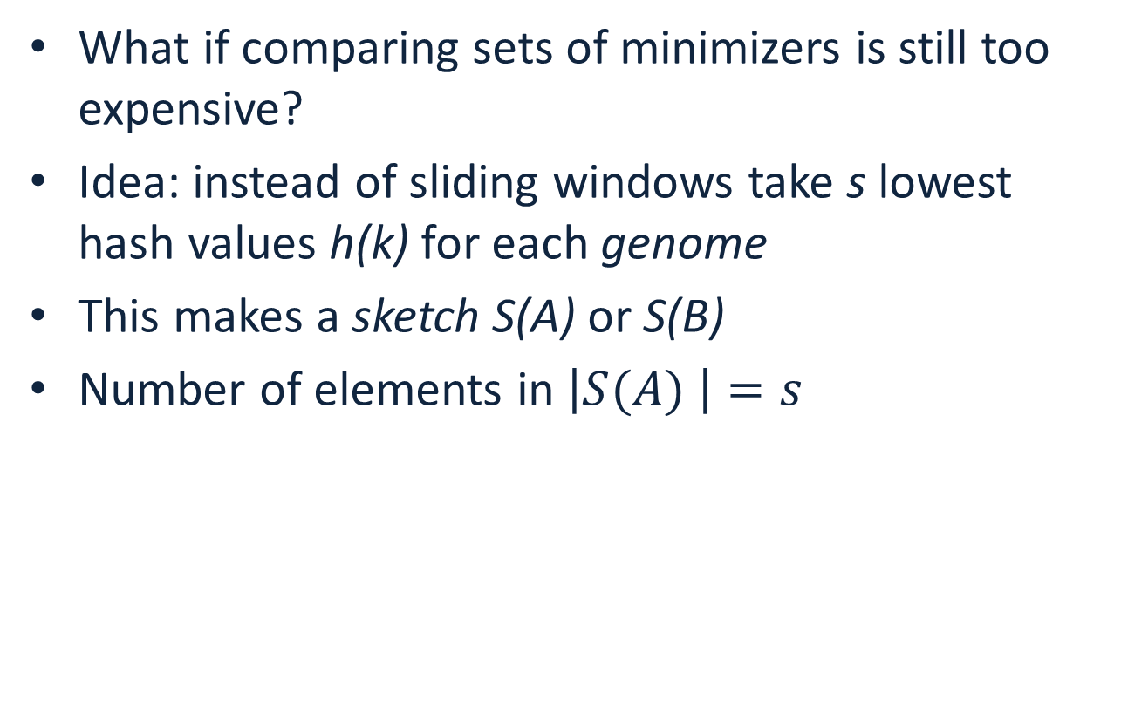
Jaccard index for genome similarity/alignment
What if comparing sets of minimizers is still too expensive?
Idea: instead of sliding windows take s lowest hash values h(k) for each genome
This makes a sketch S(A) or S(B)
Number of elements in $\left|S(A) \right|=s$
$$J(A,B)≈\frac{\left|S(A)\bigcap{S(B)}\right|}{\left|S(A)\bigcup{S(B)} \right|}≈\frac{\left|S(A\bigcup{B)}\bigcap{S(A)\bigcap{S(B)}}\right|}{\left|S(A\bigcup{B)}\right|}$$

Slide 10
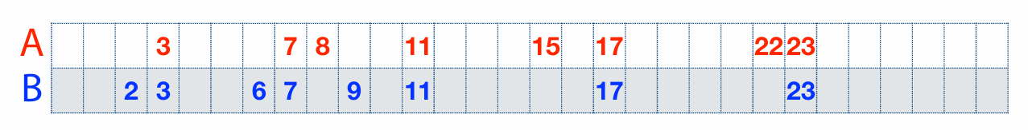
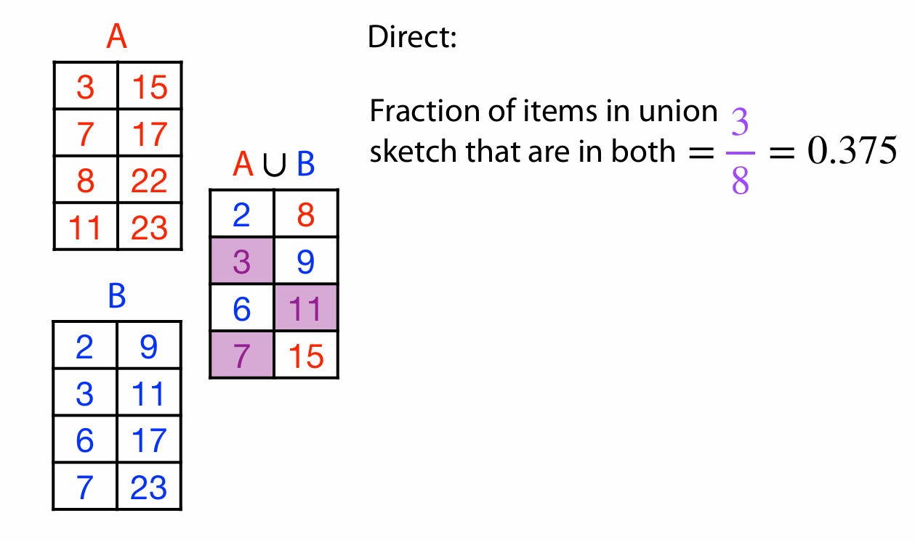
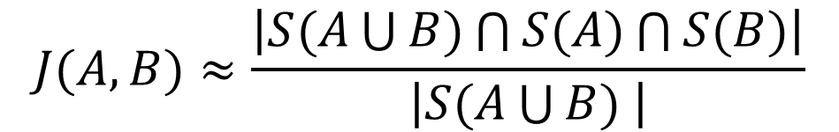



Another example
$$S(A)$$
$$S(A\bigcup{B)}$$
$$S(B)$$
$$J(A,B)≈\frac{\left|S(A\bigcup{B)\bigcap{S(A)}\bigcap{S(B)}}\right|}{\left|S(A\bigcup{B) }\right|}$$

Slide 11
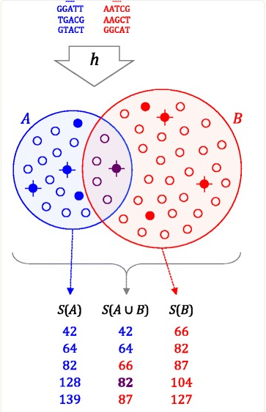

Genome distance estimation using MinHash
Reduce each genome to a MinHash(G), a set of s integers (typically 500-10000)
Compare MinHashes (sort)
$$J(A,B)≈\frac{\left|S(A\bigcup{B)\bigcap{S(A)}\bigcap{S(B)}}\right|}{\left|S(A\bigcup{B) }\right|}$$

Slide 12


Computing approximate alignments with MinHash
Can store genome positions of k-mers in the MinHash
Compute approximate alignments as clusters of shared k-mers
Requires bigger MinHash size s
Implemented in MashMap software

